Slide 1
Smoking Cessation Service Implementation
Steve King - MLCSU Medicines Optimisation Pharmacist
Anna White – Devon LPC

Slide 2
Where are you from? - Please add your name and pharmacy / trust into the chat bar so we can keep an attendance log - Please ensure you have filled in the readiness survey on PharmOutcomes after this event if you have not already done so Thank you!

Slide 3
Agenda
Background – Long Term Plan & Ottawa Model of Smoking Cessation
Pilots – overview & outcomes
National implementation update
Q&A
Notes:
Anna – handover to intro from trust TTD team

Slide 4
Background (1)
NHS Long Term Plan (LTP): commitments
Prevention is a core component of the NHS Long Term Plan (LTP). The LTP commitments that set out the NHS’s contribution to tackling tobacco dependence include:
By 2023/24 all people admitted to hospital who smoke will be offered NHS-funded tobacco treatment services
Acute, Maternity and Mental Health services
The commitments are designed to:
Be the NHS’s contribution to helping deliver a smokefree generation
Build on the good work already being delivered and to compliment current Stop Smoking Services
Focus on both physical and mental health services
Introduce a level of national direction, but with local development and delivery
Notes:
Steve

Slide 5
Background (2)
Smoking cessation programmes already exist in community settings but are variable in their involvement of pharmacy
Hospitals are adopting the Ottawa Model of Smoking Cessation (OMSC), which:
Will be adopted throughout England (NHS Long Term Plan, 2019) – led by the NHSE/I Prevention team
Is a 12-week programme
Requires follow-up smoking cessation treatment after discharge from hospital
Increased 1-year quit rates by 11% (Mullen, 2010)
Is expected to save the NHS £85m within 1 year (Royal College of Physicians, 2018)
Notes:
Steve

Slide 6
Background (3)
The aim of the NHS Smoking Cessation Service (SCS) is:
To support delivery of the prevention ambitions in the NHS LTP, and for community pharmacy to become a nationally available choice for patients to access smoking cessation support post discharge.
Notes:
Steve

Slide 7
Smoking Cessation Transfer of Care Pilots
A pilot service was introduced in October 2020 with the first location being referrals from Royal Oldham Hospital to pharmacies in the Oldham area
Pharmacies were selected following an Expression of Interest process, to give good geographical coverage and extended opening hours
A second pilot area went live in November 2021 in the Lambeth and Southwark boroughs of London, working with Guys and St Thomas’ Hospital and King’s College Hospital
The pilots have now transitioned into the Smoking Cessation Service (SCS)
Notes:
Steve

Slide 8
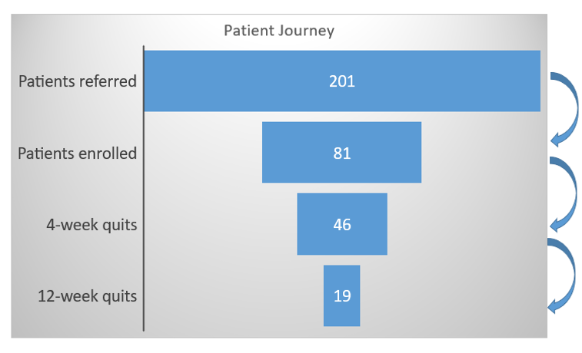
Pilot Data Overview: Oct 2020 to Dec 2021
Conversion rate of
Referrals into enrolled
patients 40%
Four week quit rate 57%
Twelve week quit rate 23%
(41% of patients recording
a quit at 4 weeks went on
to record a quit at 12 weeks)
Notes:
Steve

Slide 9
Transitioning the pilot into the SCS
Standard Treatment Programme (STP) developed with National Centre for Smoking Cessation and Training (NCSCT)
Service funding agreed (PSNC & NHSE)
Consultation fees – Community Pharmacy Contractual Framework (CPCF)
NRT costs to be recharged back to the ICB
NHS Smoking Cessation Service (SCS) specification agreed
Service launched to align with National No-Smoking Day (10 March 2022)
Registrations opened on 1 March 2022
Intentional ‘soft launch’
Notes:
Steve

Slide 10
National Implementation of SCS
The role of the CSU’s
Scoping and mapping
Understand the exact position of each Acute Trust in terms of their delivery of the relevant parts of the LTP
Inform planning
Identify key stakeholders to support working groups
Facilitate implementation at local level
Advisor available for each region
Ensure pilot sites transition successfully
Engage with early implementers and those sites looking to start delivery imminently
Production of supporting documents and promotional material
Notes:
Steve

Slide 11
3 stage process to Go-Live
Stage 1:
Scoping & Mapping
Initial engagement and establishment of working group(s).
To include OHID, Public Health, LPC, Acute Trust, ?Locally Commissioned Service
Stage 2:
Pathway agreement
Agree the pathway and the method of sending a digital referral.
Stage 3:
Community pharmacy engagement
LPCs can confidently recruit community pharmacy support.
Notes:
Steve

Slide 12
Pathway
Hospital Inpatient (undertaking a supported quit attempt)
Locally Commissioned Service
Community Pharmacy SCS
Self care – no transfer of care on discharge required
Notes:
Anna

Slide 13
NHS SCS Model of care
Notes:
Anna

Slide 14
Patient Flow
Notes:
Anna

Slide 15
NHS SCS overview for community pharmacy (1)
Intended to compliment existing locally commissioned stop smoking services
Can only see patients in the SCS who have been referred from the NHS Acute Trust and who wish to initiate / continue a quit attempt post discharge
Patient contact within 5 days of referral, at least 3 attempts to make contact, if no contact then must inform the referring Trust
Pharmacies will provide support up to 12 weeks
Consultations (no more than 2 weeks apart) can be delivered face to face or remotely, with NRT supply (max 2 weeks at a time) from agreed list of GSL products in Drug Tariff
Notes:
Anna
Nicotine Replacement Therapy list
As detailed in the Drug Tariff determination (PDF:78KB), there are 30 Nicotine Replacement Therapy (NRT) products that can be claimed for. The indicative reimbursement price for each product is based on a reference product as set out in the NRT list (Excel: 30KB).
This list also provides options of alternative products that can be supplied against each of the 30 products, if applicable. Contractors who supply these alternative products should note they can only claim, and be reimbursed for, the products listed in the Drug Tariff determination.

Slide 16
NHS SCS overview for community pharmacy (2)
Clinical record to be made of all service activity
CO monitoring for face to face consultations
No charges to patients, even if they pay for prescriptions
Patient level outcome data required to be returned to the referring NHS Acute Trust & patient’s GP
Fees: £1000 set-up fee and then £30 initial consultation, £10 interim consultations, £40 last consultation (which can be any time from week 4 to week 12) – submit claims on NHSBSA MYS
Notes:
Anna
Contractors will need to select and contract for an IT system that they can use to make their clinical records for the service. Information on IT systems that can support the service will be available soon.
NHS England and the NHSBSA are working with IT system suppliers to develop functionality that allows data from the clinical record of each service provision to be extracted and submitted to the NHSBSA’s MYS system via an application programming interface (API).
The information to be submitted via the API is specified in Appendix F of the service specification. This data will form the payment claim for the contractor and it will be used for post-payment verification (PPV) and evaluation of the service.
Clinical records of service provisions should be retained for an appropriate period of time, but for the purposes of PPV, they should be kept for a minimum of two years after the service takes place. As contractors are the data controller, it is for each contractor to determine what the appropriate length of time is, beyond two years that the clinical records are kept for. Decisions on this matter should be documented in the SOP and should be in line with Records Management Code of Practice for Health and Social Care.
Once an API is put in place by IT suppliers, claims for payment for this service should be made monthly via the MYS portal. While an API is not in place, an interim process will be used; further information on this process is available on the NHSBSA website.

Slide 17
NHS SCS training
The National Centre of Smoking Cessation Treatment (NCSCT) Stop Smoking Practitioner Certification (pharmacists that are already certified do not need to repeat their training for the purposes of this service)
Specialist NCSCT modules to support treatment for people with a mental health condition and pregnant women (these must be completed after the NCSCT Practitioner training has been successfully completed)
NCSCT module on using e-cigarettes
Pharmacists must have read the NCSCT Standard Treatment Programme (STP), which will be used to support consultations
Also need CO monitor and SOP in place to sign up on BSA
Notes:
Anna

Slide 18
Useful references
PSNC page:
https://psnc.org.uk/services-commissioning/advanced-services/smoking-cessation-service/
Service spec:
https://www.england.nhs.uk/primary-care/pharmacy/pharmacy-integration-fund/nhs-smoking-cessation-transfer-of-care-pilot-from-hospital-to-community-pharmacy/
MLCSU dashboard:
https://medsopt.midlandsandlancashirecsu.nhs.uk/nhs-smoking-cessation-service/
Standard Treatment Programme (STP):
https://www.ncsct.co.uk/pub_NHS-pharmacy-SCS.php
PharmOutcomes training for pharmacy staff:
https://drive.google.com/drive/folders/1eDzX83UJqOxdPD21JIOWBgBu944Gf93Q
Notes:
Anna

Slide 19
Smoking Cessation Service Implementation
Thank you for listening
Q & A Session
Notes:
Anna – Q&A session

