Slide 1
Services update
^{October 2022}
How to maximise your pharmacy income and ensure your patients are being supported through delivery of nationally commissioned services
Updates
Services
DMS – Smoking Cessation – GP CPCS

Slide 2
Accurate as of 10.10.22
GP practices across the county are live with and making referrals for GP CPCS to pharmacies via NHS Mail – please ensure you are checking your inboxes at least 3 times a day and actioning referrals! See Quick Service Guide from September 2022 update for reporting & claiming info.
Hospital trusts are increasing DMS referrals to pharmacy in Devon (they are expanding from only referring blister pack patients to all on high risk medicines). There are still over 400 Outstanding DMS referrals. Please ensure you are actioning DMS referrals stage 1 within 72 hours and recording all data onto PharmOutcomes See Services update from August 2022 for further information.
We still only have 57 contractors signed up to the Advanced Smoking Service, it would be great if we had more coverage. RDUH are now live with the service – please ensure you have filled out the ‘Smoking Cessation Advanced Service - state of readiness’ survey on PharmOutcomes as they will only send referrals to you once you have submitted this.

Slide 3
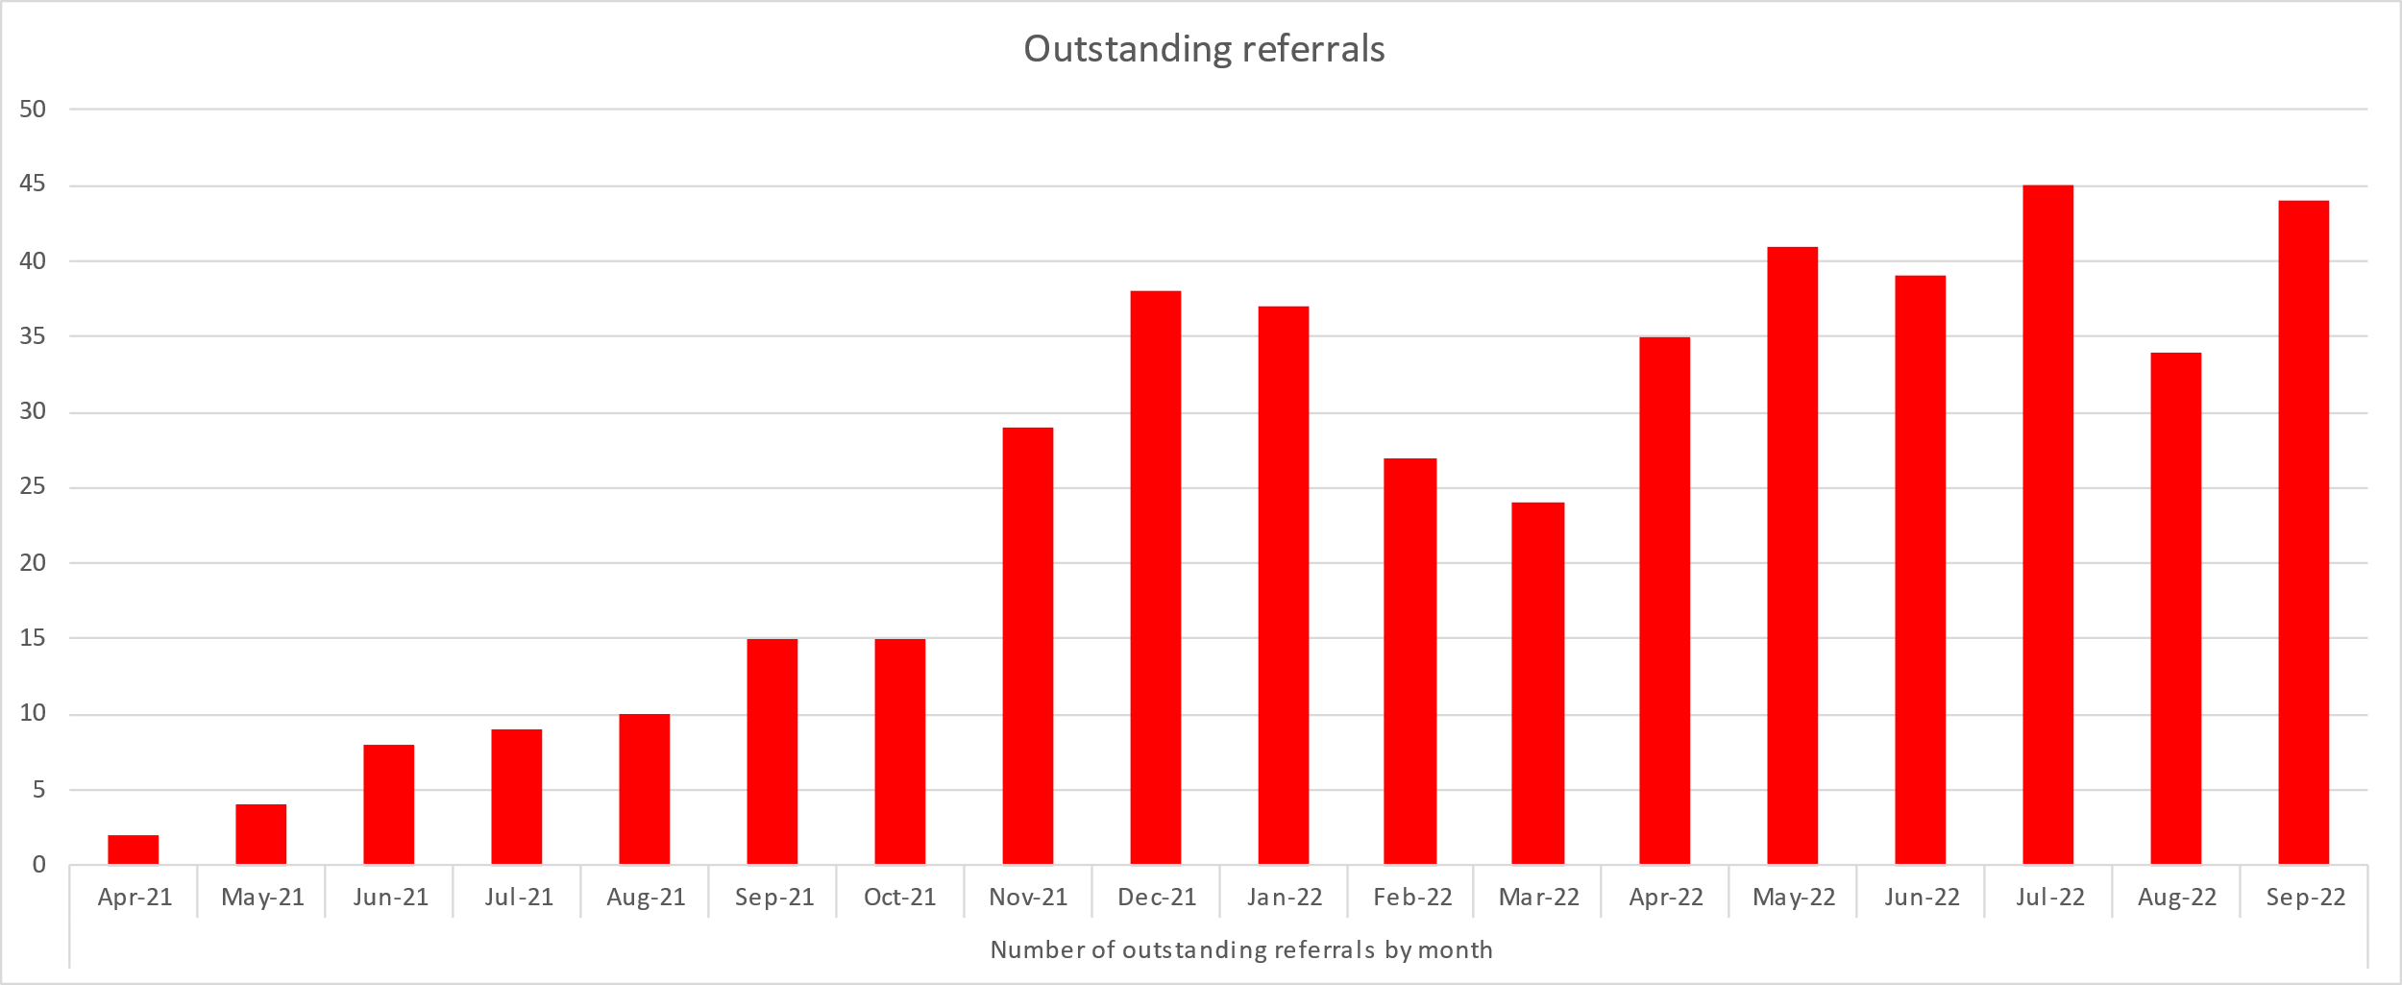
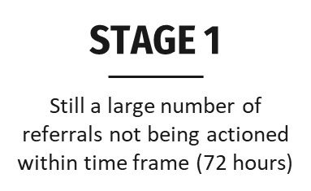
DMS Essential service
All trusts in Devon are live and sending referrals to pharmacies via PharmOutcomes
They have recently agreed to expand referral categories to include all high risk, rather than just those on blister packs
Trust sends referral via PharmOutcomes
Pharmacy action at Stage 1 within 72 hours
Complete each stage if appropriate and log all data onto PharmOutcomes
Run DMS report from PharmOutcomes and manually enter data onto MYS to claim
DMS - challenges
RECORDING
Anecdotal feedback that some pharmacies are printing from PO, then adding to MYS, skipping logging data on PO

Slide 4
Smoking Cessation Service Advanced service
RDUH (formerly RD&E) are now live with the service
They will start sending referrals to you once you have completed the Smoking Cessation Advanced Service - state of readiness survey on PharmOutcomes (if you are signed up and registered to provide)
The other trusts in Devon are all expected to go live in Q3 (Oct – Dec 2022)
Initially the trusts will be sending referrals to you via NHS Mail – the same route that GP CPCS referrals are sent to you – please ensure you are checking your inbox regularly
Currently there are 58 contractors signed up and coverage across Devon is patchy
Smoking Cessation Service - challenges
SIGN UP
TEAM
TRAINING
MULTIPLES
NOTICE
Not all team members aware
Central sign up, teams unaware
Signed up but no training or equipment in place
All pharmacists need to complete (100% hours)
28 days notice required to withdraw from service

Slide 5
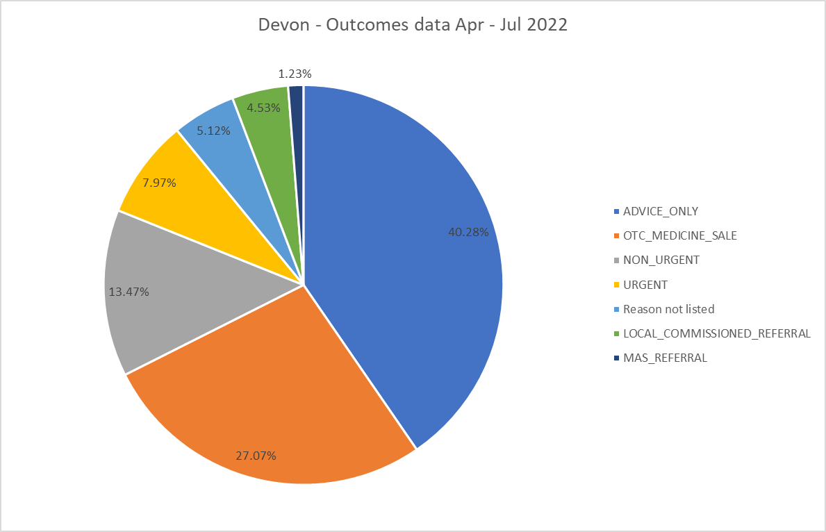
GP CPCS
GP CPCS - challenges
CLOSURES
CONTACT
REFERRALS
Driving lack of confidence with GP practices & patients
Patients not being contacted within the agreed 4 hours
Referrals not being picked up - should be checking NHS mail 3 times a day
LOCUMS
INFO
Need to complete full, contemporaneous notes on PO
Locums can & should deliver the service – it’s a minor illness consultation

