Slide 1
Welcome to Orion Medical Supplies A guide to the pharmacy Single Kits available across the Devon CC scheme

Slide 2
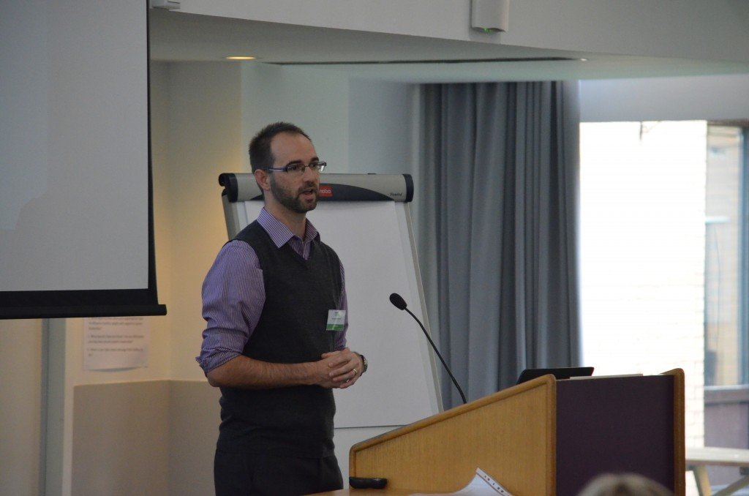
Thank You
“I would personally like to open this
presentation with a thank you
too the Community Pharmacies for
their continued engagement in the
provision of NSP. This is incredibly
valuable and important in the
managing of BBVs, reducing stigma,
and being compassionate to those
who have experienced multiple
traumas”.
Richard Merrifield – Senior Commissioning Manager
Devon County Council

Slide 3
Transition to a Single Kit Pharmacy Model
Developed to support Commissioners and Drug Services to provide a product that not only promotes best practice but improves value for money
This kit enables clients to take only what they need, therefore reducing unused drug litter created from clients having to take larger packs.
More importantly it has a Single Use Sharps Container that enables safe disposal of the used injecting equipment.
The Single Kits directly promotes non-sharing of equipment to ensure minimum exposure to Blood Bourne Viruses.
This is achieved by providing all equipment needed in individual packaging to carry out one injection.

Slide 4
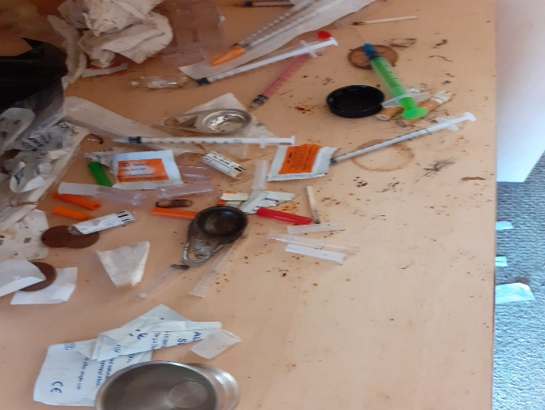
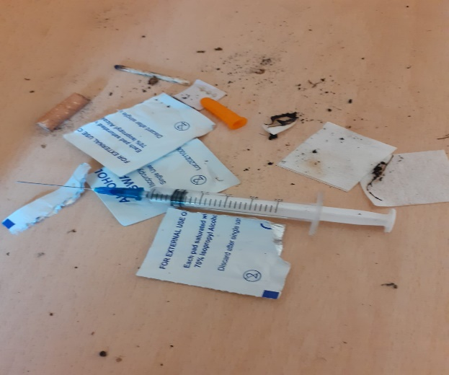
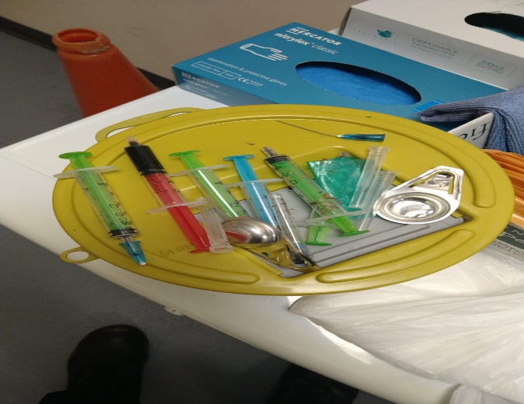
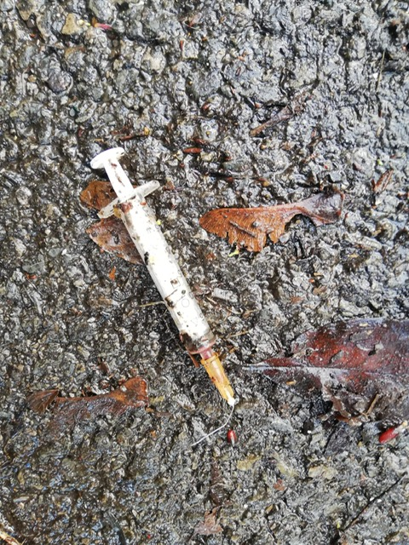
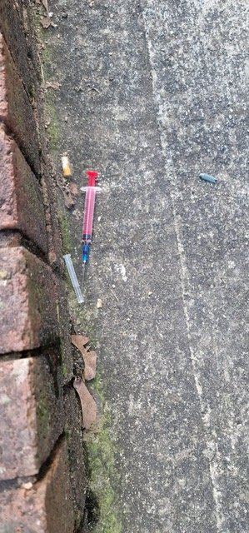
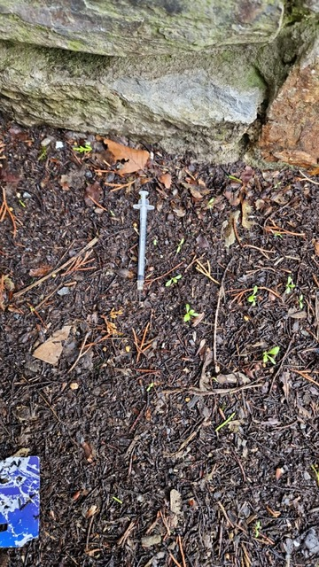
Local Drug Litter Issues

Slide 5
Benefits of the Single Kits
Encourages Safer Injecting Practice
Reduces the Spread of BBVs
Promotes Non-Sharing Through Single Use Items
Provides Individually Wrapped Clean Sterile Equipment
Increases Use of Sharps Containers
Delivers Improved Value for Money
Reduces Used Drug Litter
Reduces Unused Equipment Waste
Complies with Best Practice & NICE PH52 Recommendations
Eliminates Accidental Sharing and Re-Using Equipment

Slide 6
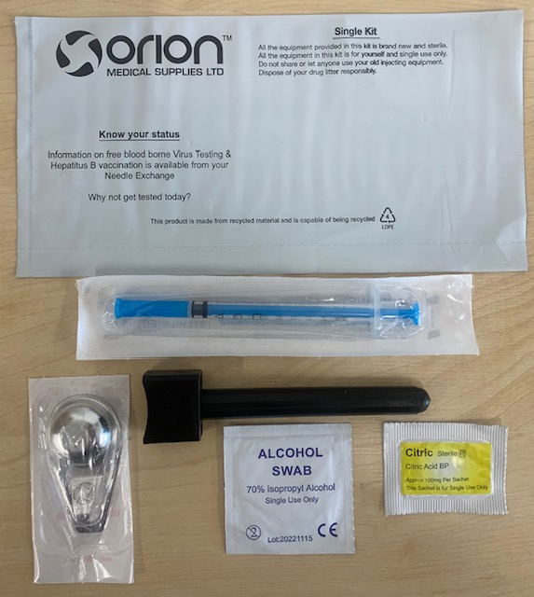
1ML Single Kit Black – OMP915
Contents
1 x Safeloc One, Black Single Needle NX Container
1 x Acufine 1ml 29g Insulin Complete
1 x Sterile Spoon
1 x Citric Sachet
1 x Alcohol Swab
Clients
Opiate Clients – Heroin, Methadone, Morphine, Fentanyl, Tramadol
Injection Sites to Include:- Hands, Arms, Legs, and Feet

Slide 7
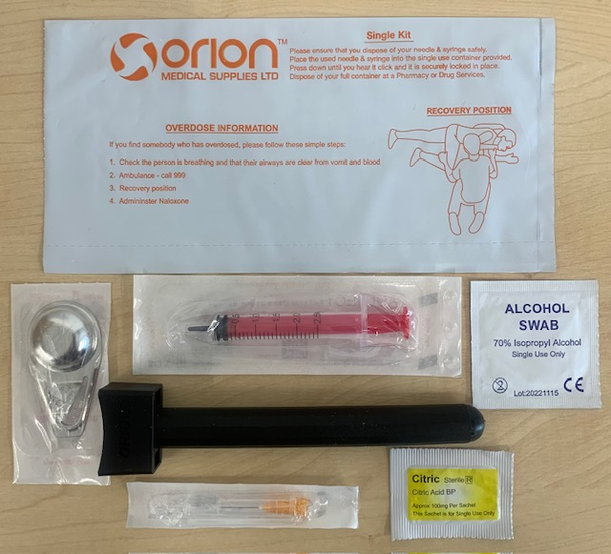
2ML Single Kit Orange – OMP925
Contents
1 x Safeloc Two, Black Single Needle NX Container
1 x Acuject LDS 2ml Syringe
1 x Orange 5/8” 25g Acucan Needle
1 x Alcohol Swab
1 x Citric Acid Sachet
1 x Sterile Spoon
Clients
Opiate Clients – Heroin etc
Groin Injectors

Slide 8
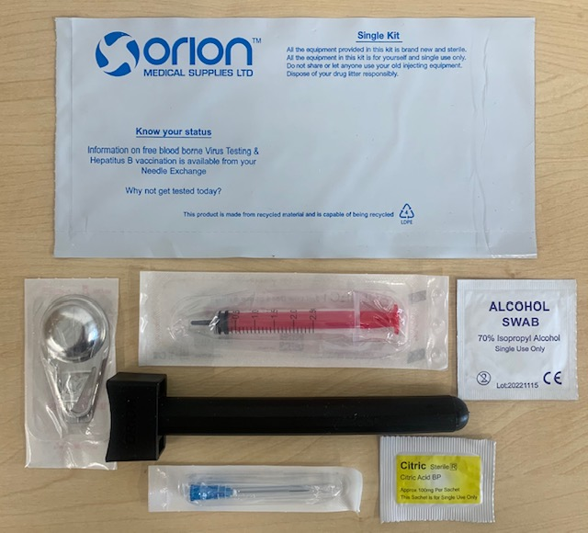
2ML Single Kit Blue – OMP928
Contents
1 x Safeloc Two, Black Single Needle NX Container
1 x Acuject LDS 2ml Syringe
1 x Blue 1 ¼” 23g Acucan Needle
1 x Alcohol Swab
1 x Citric Acid Sachet
1 x Spoon
Clients
Opiate Clients – Heroin etc
Groin Injectors – Longer, thicker needle enabling penetration through scar tissue

Slide 9
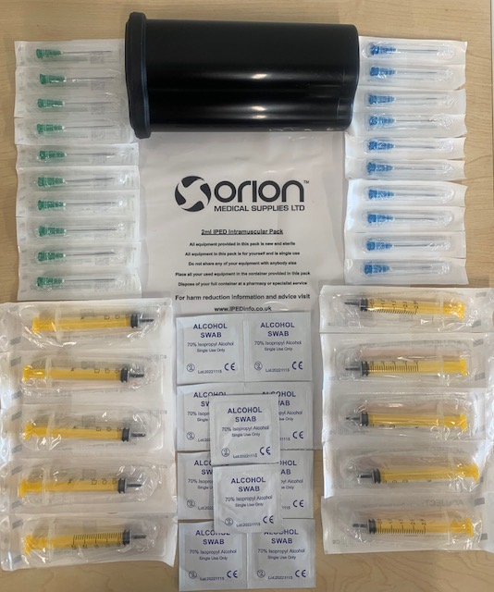
2ml IPED Kit – OMP287
Contents
1 x 0.35L Pocket Needle Bin
10 x Acuject 2ml LDS Syringe
10 x 23g 1 ¼” Blue Needle
10 x 21g 1 ½” Green Needle
10 x Alcohol Swab
Clients
Steroid users – Gym goers – intramuscular
Injectors

Slide 10
Peer Distribution & Increased Returns Rates
You should continue to allow peer distribution of clean injecting equipment from your pharmacies
You should not limit the number of Single Kits a client receives
The Single Kit model allows clients to take exactly what they require; they are no longer forced to take a larger pharmacy pack if they only require 2-3 pieces of equipment
This will automatically decrease the amount of drug litter being reported in the local area
A client will only take what they need, there is no sense in them taking extra
As each Single Kit contains an individual single use sharps bin the Single Kit promotes point of use disposal of used equipment
Disposing of used equipment at point of use means that this can not be shared or reused, this simple act can help to reduce the spread of BBV’s such as Hep B, Hep C, and HIV
Encouraging your clients to return their individual sharps bins more frequently will help you to develop a better relationship with your clients. This relationship can lead to further healthcare interventions, and a greater respect and understanding of their situation

Slide 11
Question Time
Thank you for taking the time to read through this
presentation on how the provision of NSP is
changing across Devon as a direct result of the
increased levels of drug litter being found locally.
Now is the time for you to ask any questions or
raise any queries on this change.
Please email any questions to
gareth@orionmedical.co.uk who will process these
and reply to you directly with an answer or
resolution to your issue.

