Slide 1
C@SHiP Scheme
June 2023

Slide 2
Access to FREE condoms for 13-24 year old’s living in Plymouth via a digital platform

Slide 3
What is needed to sign up to the scheme?
A mobile telephone number
An email address
Any young person who does not have a mobile or email should not be deterred from accessing free condoms.
They can be directed to:
SHiP
Cumberland Centre
The Zone
Where condoms can be provided outside of the scheme.

Slide 4
Digital Platform Young person registers to a Personal Health Record (PHR). The link to the PHR can be accessed via the SHiP website or via QR code
https://yourship.uk

Slide 5
Sexual Health Promotion
Prior to registering to the PHR the young person will be asked to view 2 videos
How to use a condom
Consent

Slide 6
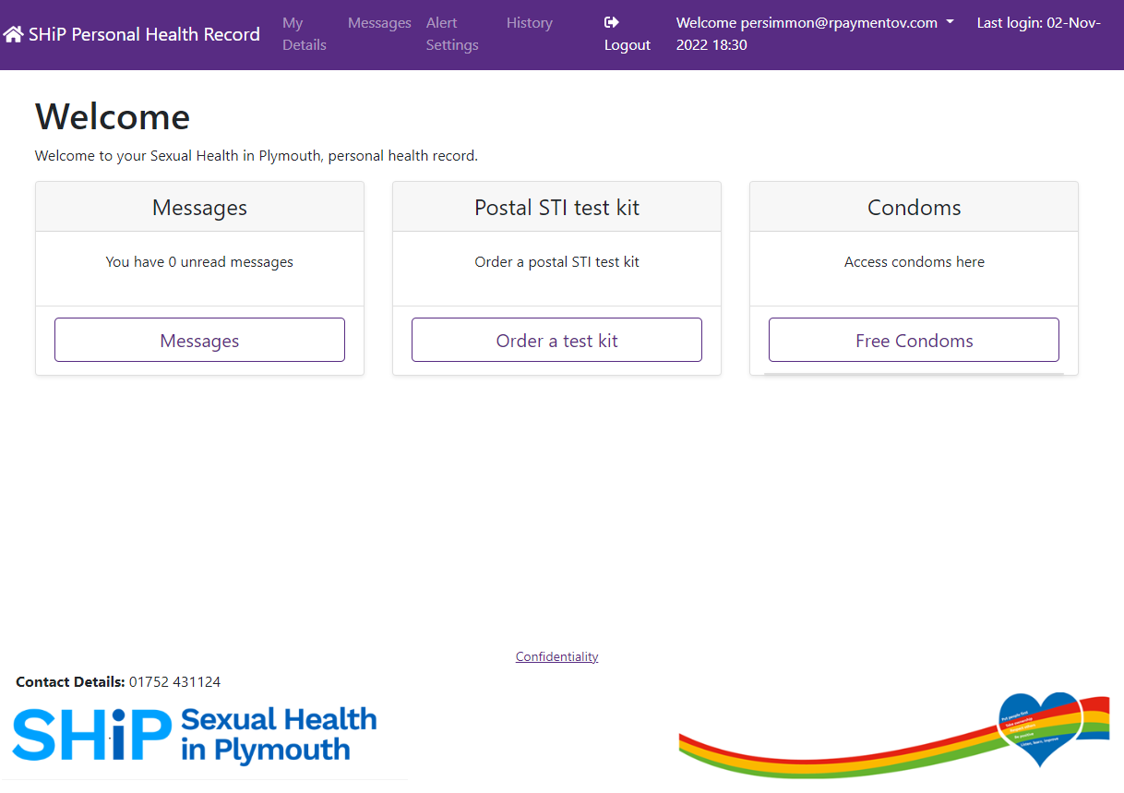
PHR Homepage

Slide 7
What do they get?
24 Regular condoms to cover a period of 12 weeks
Option to include Lube
Option to have Latex-Free condoms
Access to order a postal STI test kit

Slide 8
How do they get the condoms?
Posted to an address of their choice
(this does not have to be their registered address)
Collection from one of our distribution sites

Slide 9
Our Distribution sites
SHiP, Derriford Hospital
Cumberland Centre (Monday only)
The Zone, Union Street
Boots, Drakes Circus
Boots, The Broadway, Plymstock
Boots, The Ridgeway, Plympton
Boots, Mutley Plain
City College Plymouth (students only)
Efford Youth Centre
Honicknowle Youth Centre
Hyde Park Pharmacy, Mutley
Jan Cutting Healthy Living Centre, Beacon Park
Plymouth Marjon University
The Rees Centre, Plympton
Southway Youth Centre
Tavistock Clinic
University of Plymouth (students only)

Slide 10
Safeguarding 13, 14 and 15 year olds
Anyone in this age group will be able to register to a PHR.
They will not be able to progress onto postal condoms or collection until they have spoken with one of our Sexual Health Advisors
The PHR will automatically task the young person to our <16 condom request task list
The young person will be aware that they will need a call before accessing their condoms
The Sexual Health Advisor will aim to call them within 2 working days
Safeguarding will be assessed and sexual health promotion discussed
Young person will then have access to condoms

Slide 11
Safeguarding 16 and 17 year olds
Anyone in this age group will be able to register to a PHR
Prior to ordering condoms they will be asked to answer our safeguarding questions
Any Safeguarding triggers will automatically task the young person to have a call from our Sexual Health Advisors
The young person will be aware to expect a call from a Sexual Health Advisor
The Sexual Health Advisor will aim to call them within 2 working days
Their condom order will not be delayed, they will be able to progress through to ordering condoms via post or from a collection site

Slide 12
The Zone, Union Street
Anyone accessing The Zone in the age group 13-17 year old will see a youth support volunteer who will assess Safeguarding before signing them up to the scheme.
Safeguarding at The Zone is linked to the SHiP IT system.

Slide 13
How can you get involved?
Please promote the scheme by displaying our poster within your service.
Remember: Young people who do not have access to a mobile phone or an email can be directed to SHiP, the Cumberland Centre or the Zone where they can be supplied with condoms outside of the scheme.

