Slide 1
Training offers for community pharmacy
Current live offers
August 2024

Slide 2
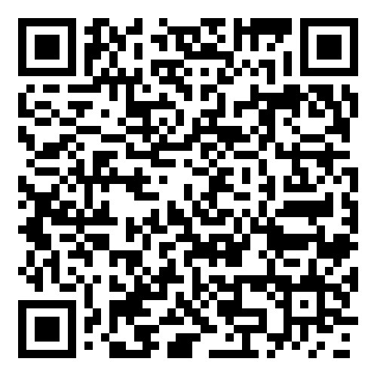
Get ahead for Pharmacy First with NHS funded training
Educational supervisor training including DPP training
Community pharmacy technician: advancing your role
Independent prescribing for community pharmacists – offer now LIVE
NEW: National Teach and Treat Pilot
Find out more on the Health Education England website: Community Pharmacy Training
Current live offers

Slide 3
NEW: National Teach and Treat Pilot
Following the success of the South West region Teach and Treat pilot we will be rolling out a national pilot starting Summer 2024
We will be welcoming bids from the remaining six regions within England:
London
South East
Midlands
East of England
North East Yorkshire
North West
We encourage a variety of models with a range of options to utilise this funded opportunity. The project site can be hosted within any organisation with a prescribing mandate and suitable clinical setting, including NHS Trusts and Foundation Trusts, community pharmacies, primary care networks and general practices. Bids can be individually led or from joined up organisations within the region.
Applications open on Monday 22nd July and close on Monday 12th August at midday. Apply using our MS form which includes guidance on how to apply.
For more information or any questions please contact us on england.pharmacyteam@nhs.net

Slide 4
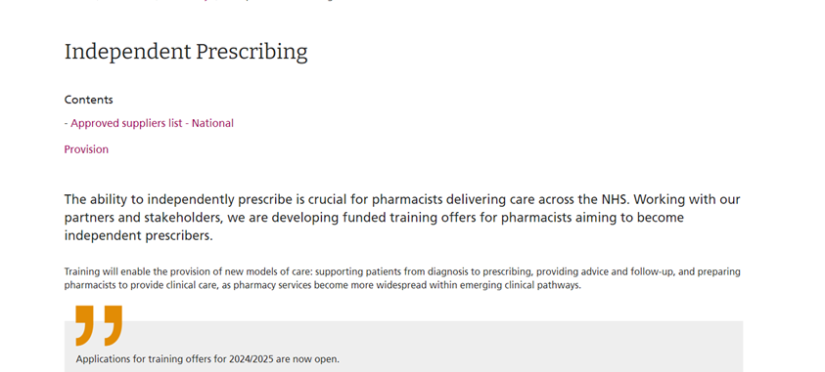
Independent Prescribing training
Please visit the Health Education England website for current training offers

Slide 5
Educational supervisor training including DPP
Two programmes on offer:
Training for Educational Supervisors including Designated Supervisors. Both pharmacists and pharmacy technicians can apply for the educational supervisor training.
Training for Designated Prescribing Practitioners (DPP) supporting supervision of learners from a community pharmacy setting (i.e. community pharmacists completing independent prescribing training, where this training may be taking place in other healthcare settings)
Sign up now for training on the ProPharmace website
Notes:
Plain slide with subhead and bullets

Slide 6
What is the Community pharmacy technician: advancing your role learning programme?
Four-month structured development programme which supports pharmacy technicians working in community pharmacy to develop and demonstrate confidence and competence in delivering services and advancing pharmacy technician roles.
The programme aims to build on pharmacy technicians’ initial education and training in order to advance the community pharmacy technician role and widen the skill mix in the community pharmacy team, which will increase patient access to clinical services.
The programme takes a blended learning approach and offers a mix of online learning, face-to-face and online workshops, workplace-based practice and peer support sessions.
Sign up now on the CPPE website
Notes:
Plain slide with subhead and bullets

Slide 7
Thank you
Please contact your local team for more information:
england.wtepharmacy.nw@nhs.net
england.wtepharmacy.ney@nhs.net
england.wtepharmacy.se@nhs.net
england.wtepharmacy.mids@nhs.net
england.wtepharmacy.eoe@nhs.net
england.wtepharmacy.london@nhs.net
england.wtepharmacy.se@nhs.net
england.wtepharmacy.sw@nhs.net

